Slide 1
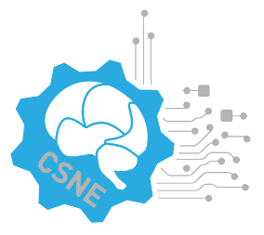




Implantable, flexible microelectrodes for simultaneous neuronal recording and stimulation.
Anna Smith, Michael Jones and Samuel Oaks
Department of Biology, University of Washington, Seattle, WA
Introduction
Results
Discussion
Conclusions
Methods
References

